Slide 1

Spotify Audio Feature Exploration
Dung Nguyen
November 14th, 2021

Slide 2




“If I were not a physicist, I would probably be a musician. I often think in music. I live my daydreams in music. I see my life in terms of music.” ― Albert Einstein
Spotify
the world's leading audio streaming subscription service with 158M premium subscribers, and a market share of 32% (statistics of 1st quarter of 2020 by Investors)
>73M pieces of tracks and podcasts (updated by 9.2021)
discover popular artists and tracks,
find out interesting audio features

Slide 3
Agenda
I. Objective
II. Dataset Overview
III. Data Cleaning
IV. EDA
V. Conclusions

Slide 4



Objective
Most popular artists and tracks on Spotify?
What kinds of audio characteristics are associated with the most popular songs?
Are there any correlations between tracks’ audio features themself?
Listeners get better understanding of their musical tastes and discover new music
Some suggestions for musicians to make hits on Spotify platform

Slide 5



Datasource
Dataset which was originally collected from Spotify API is downloaded from Kaggle website
Dataset includes > 130k audio tracks updated until April 2019
Each audio track contains various attributes

Slide 6

Dataset Overview
Valence
Tempo
Danceability
Energy
Key
Duration
Mode
Loudness
Speechiness
Instrumentalness
Liveness
Acousticness
Popularity

Slide 7
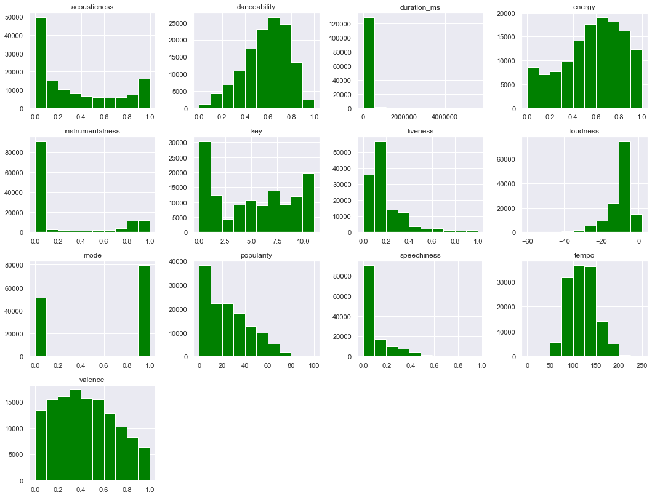
I. Dataset Overview
Data Distribution
Tracks’mood: tempo seems to follow a normal distribution Danceability and energy appear to be skewed left
Tracks’ properties: while speechiness and instrumentalness are skewed right, loudness follows a skewed left distribution

Slide 8
I. Dataset Overview
Data Distribution
Tracks’ context: recorded > performed live
And tracks are more electronic rather than acoustic
Tracks’ key & mode: most used keys seem to be C & C♯
Major mode constitutes for
around 60% of track's mode

Slide 9
I. Dataset Overview
Data Distribution
Tracks’ duration: mainly distributed in range from
0 to 500000 miliseconds
-> convert to minutes
Tracks’ popularity: 75% get popularity score <=40. Only ¼ of the total of tracks get score > 38

Slide 10

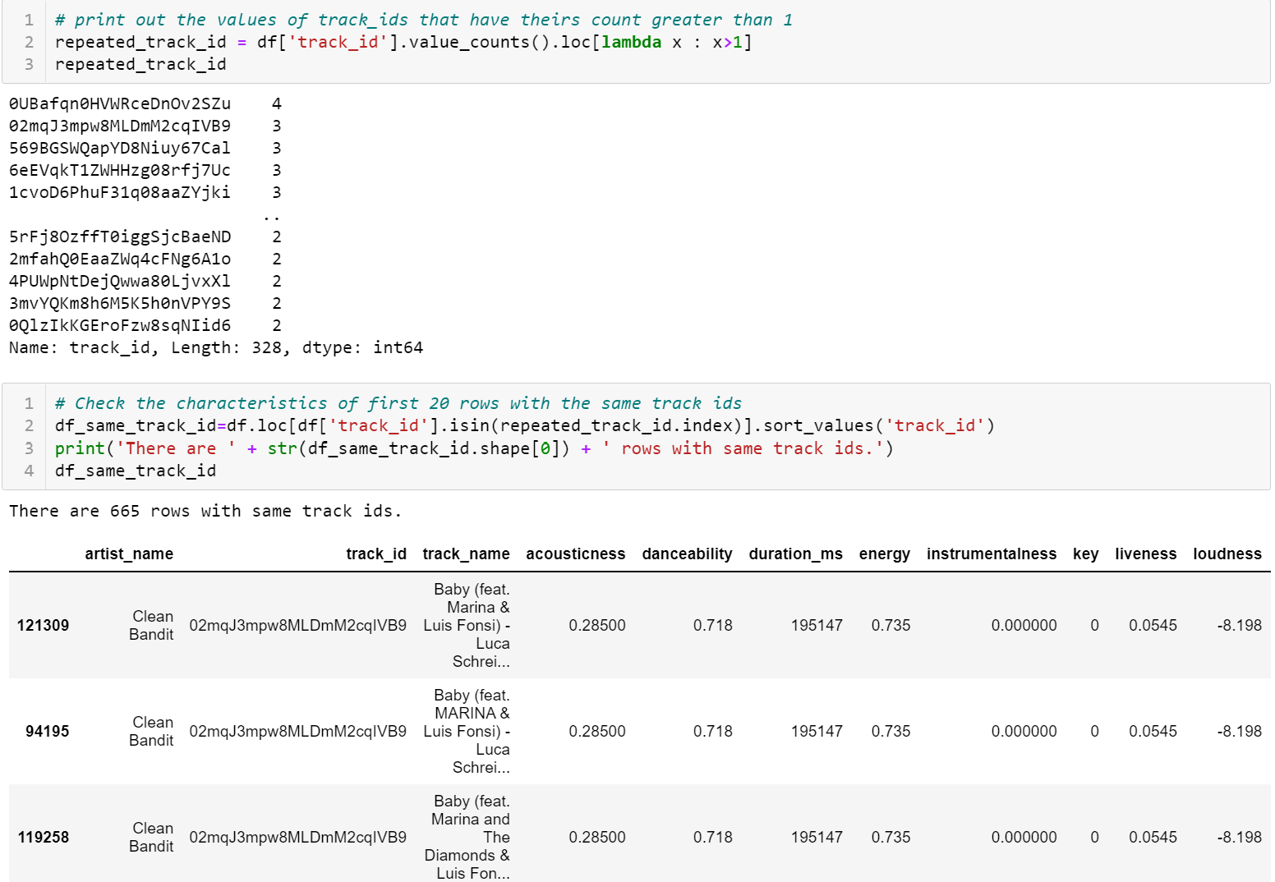
Data Assessing & Cleaning & Feature Engineering
Assessing
Duplicated rows with same track_id
130663 rows & 17 columns
No missing values
No duplicated rows, but deeper investigation reveals that there are rows sharing all same values but different track_names -> drop those rows
Data types are correct for all columns except mode which should be boolean instead of integer
Duration in miliseconds is not intuitive for interpretation -> feature engineering to minutes

Slide 11
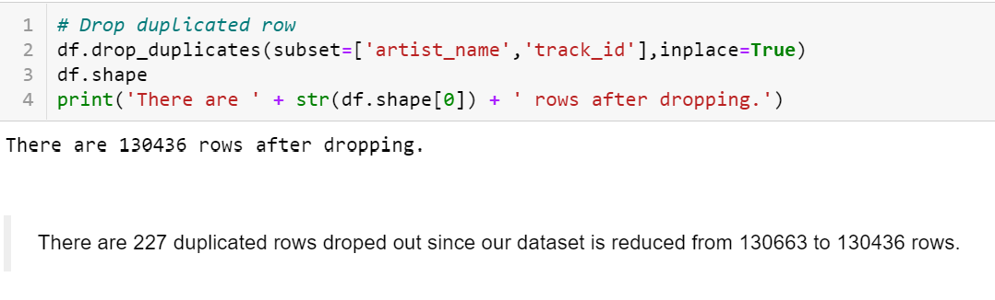
Data Assessing & Cleaning & Feature Engineering
Duplicated rows with same track_id
Drop those duplicated rows

Slide 12
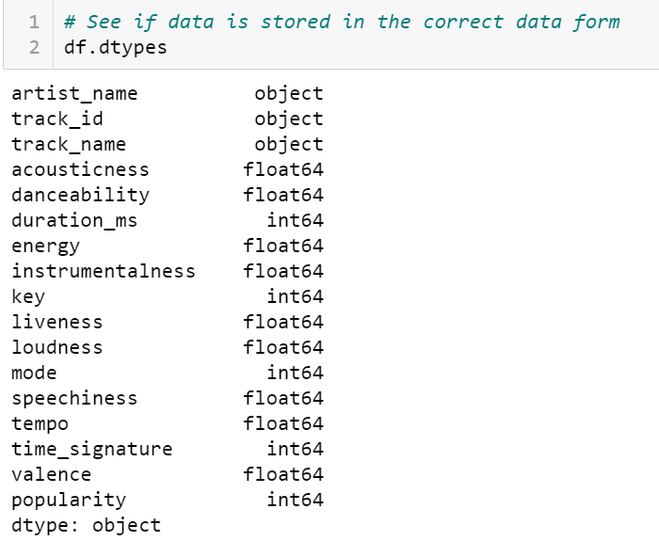
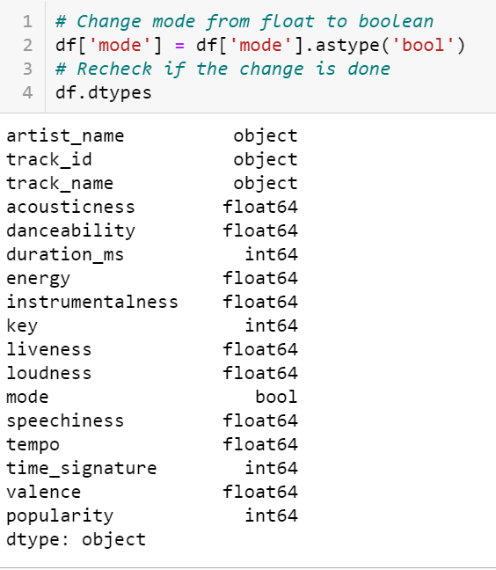
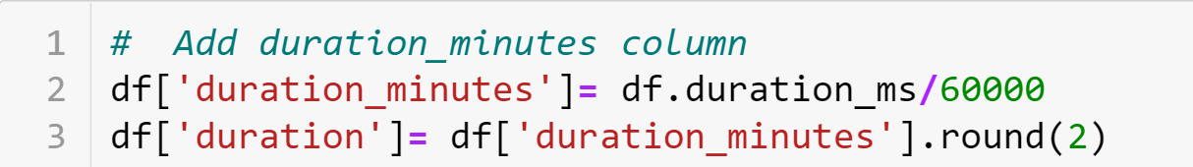
Data Assessing & Cleaning & Feature Engineering
Mode to boolean
Duration to minutes

Slide 13
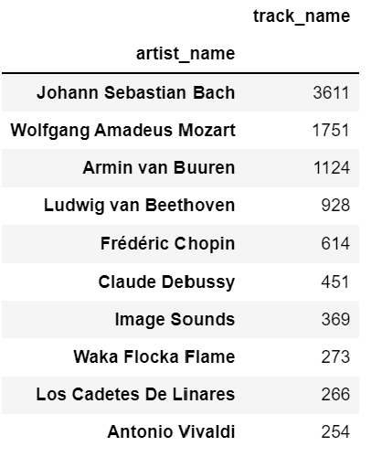
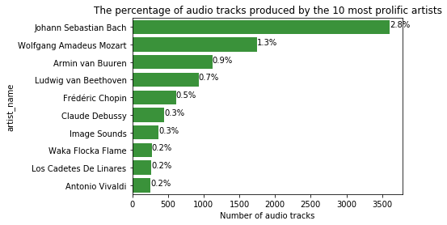
EDA - Research Question 1: Most popular artists and tracks? 1.1. Who are top 10 prolific artists?
Bach was considered to be the busiest musician of all time till 2019 with >3600 tracks
Mozart came second with 1751 masterpieces.
Interestingly, 6 out of 10 productive artists are one of the most best-known classical composers of all time
The rest 4 artists represents for electronic music, rap and ballad genre respectively

Slide 14
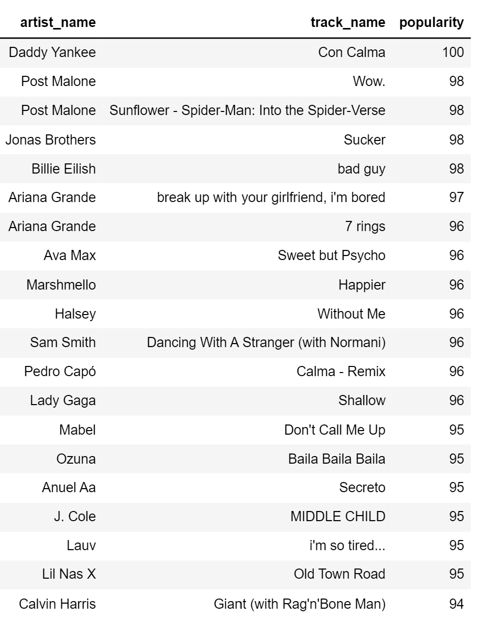
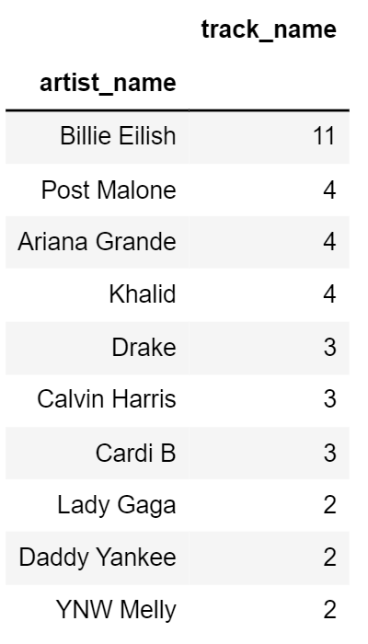
EDA - Research Question 1: Most popular artists and tracks 1.2 Which artists and tracks are most played-back in the spring of 2019?

Slide 15
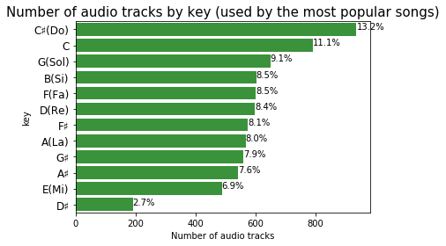
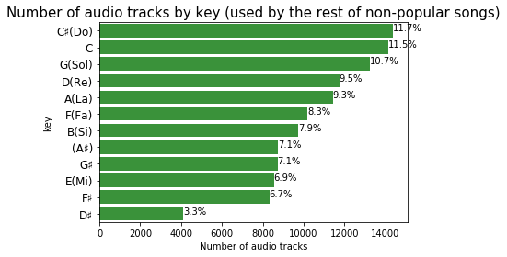
EDA - Research Question 2: Which are the characteristics of the most popular songs in the spring of 2019? And how are the most popular songs different from the rest of songs?
In term of key
C♯, C Major and G Major dominate other keys both in most popular vs non-unpopular tracks.

Slide 16
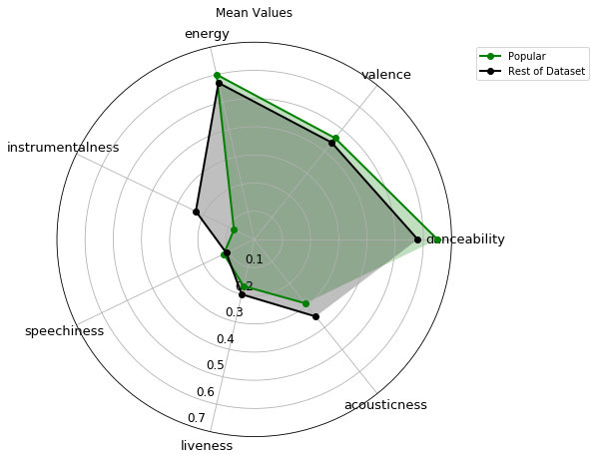



EDA - Research Question 2: How are the most popular songs different from the rest of songs?
In term of mood, property and context
Most popular songs have tendency to be:
more energetic, happier and more danceable
less acoustic with piano/violin
but significantly more vocal
Songs have higher likelihood to become hits if
they offer Spotify listeners the more compelling vocals, cheerful and positive feelings

Slide 17

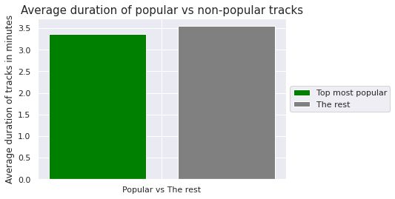
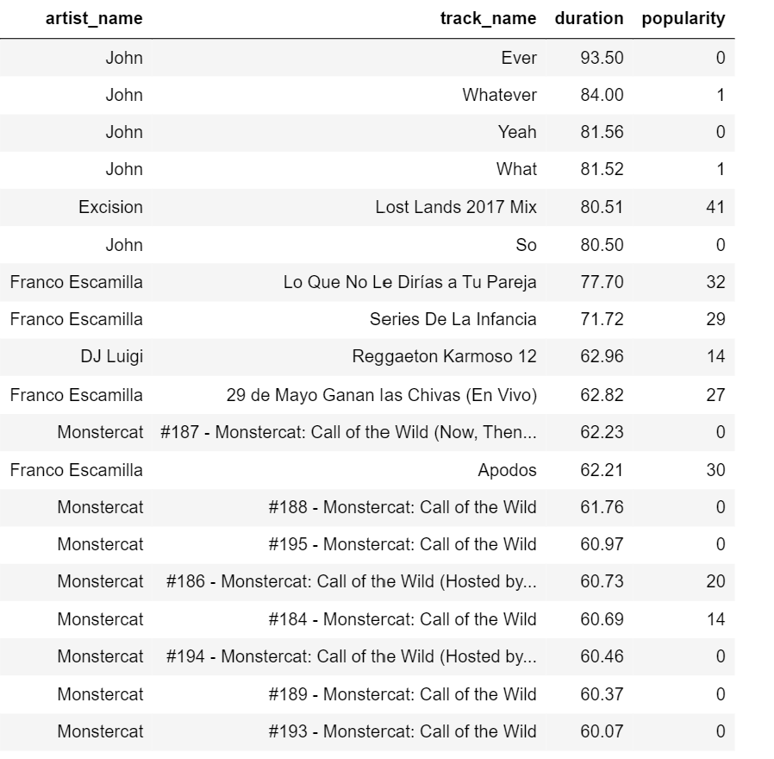
EDA - Research Question 2: How are the most popular songs different from the rest of songs?
In term of duration
Tracks longer than 1 hour

Slide 18
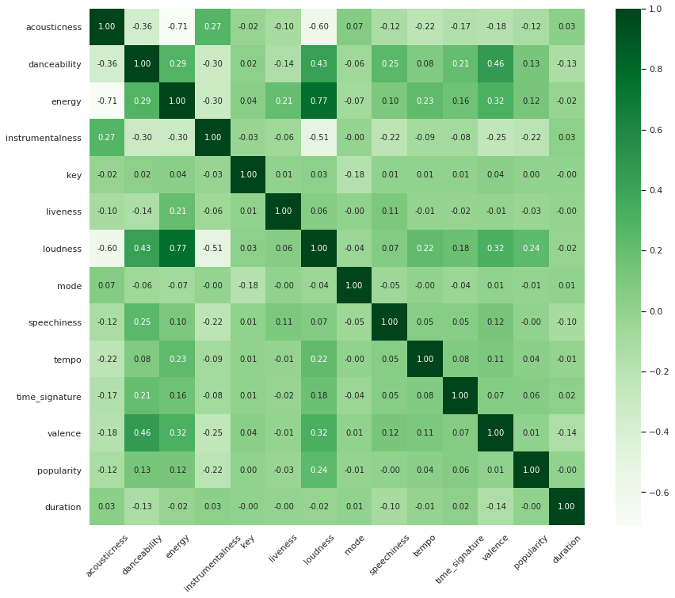
EDA - Are there any strong correlations between audio features themself?
loudness and energy has the highest correlation of 0.77
the 2nd highest positive association is between danceability and valence
popularity is slightly positive correlated with instrumentalness, acousticness and liveness

Slide 19

V. Conclusions: findings and recommendations
Most prolific artists are of all time best-known composers of classical music. Bach and Mozart were the most prolific
The most popular song is Con Calma by Daddy Yankee & the artist with record of hits is Billie Eilish
C ♯, C and G dominate other keys due to theirs convenience and ease to play on piano and guitar
Higher energy and louder songs outperform low energy and quieter ones
Audiences prefer compelling vocals & fresh, cheerful and positive feelings ignited by the tracks

Slide 20

V. Conclusions: findings and recommendations
Live performance are less preferred compared to recorded audios
On average, shorter duration are expected to give track higher popularity
Generally, higher energy and louder tracks have a greater chance to become popular
Using electronic instruments can improve the chance of success for musicians
These findings do not imply any statistical conclusions
→ Data should be further inspected with proper statistical test in order to drive more potential correlations

Slide 21

MUSIC FOR EVERYONE
MUSIC FOR EVERYONE
Thank you ☺
THANK YOU!

